Slide 1

Marc Benedí

Slide 2

SLAM
https://gitlab.com/paverobotics/vehicle/vehicle-core
vehicle-core/localization/warp_slam

Slide 3
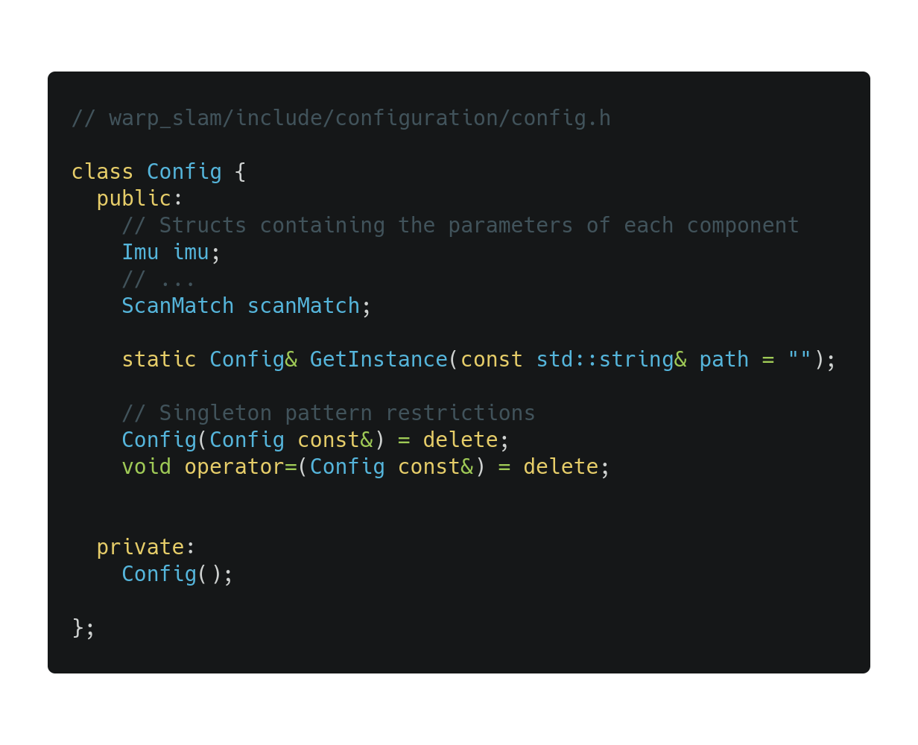
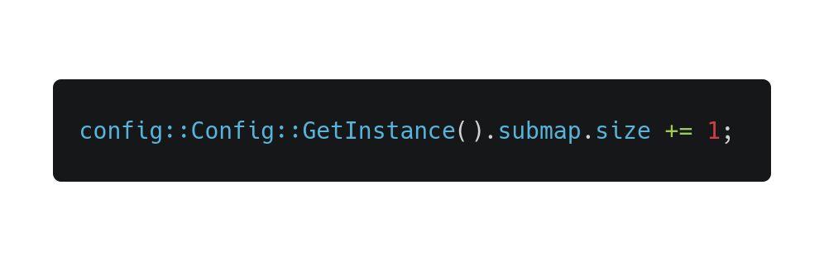
Configuration
A class that holds all the parameters
Singleton pattern
Can only be accessed through the method GetInstance()
Parameters can be dynamically changed using ROS dynamic reconfigure

Slide 4
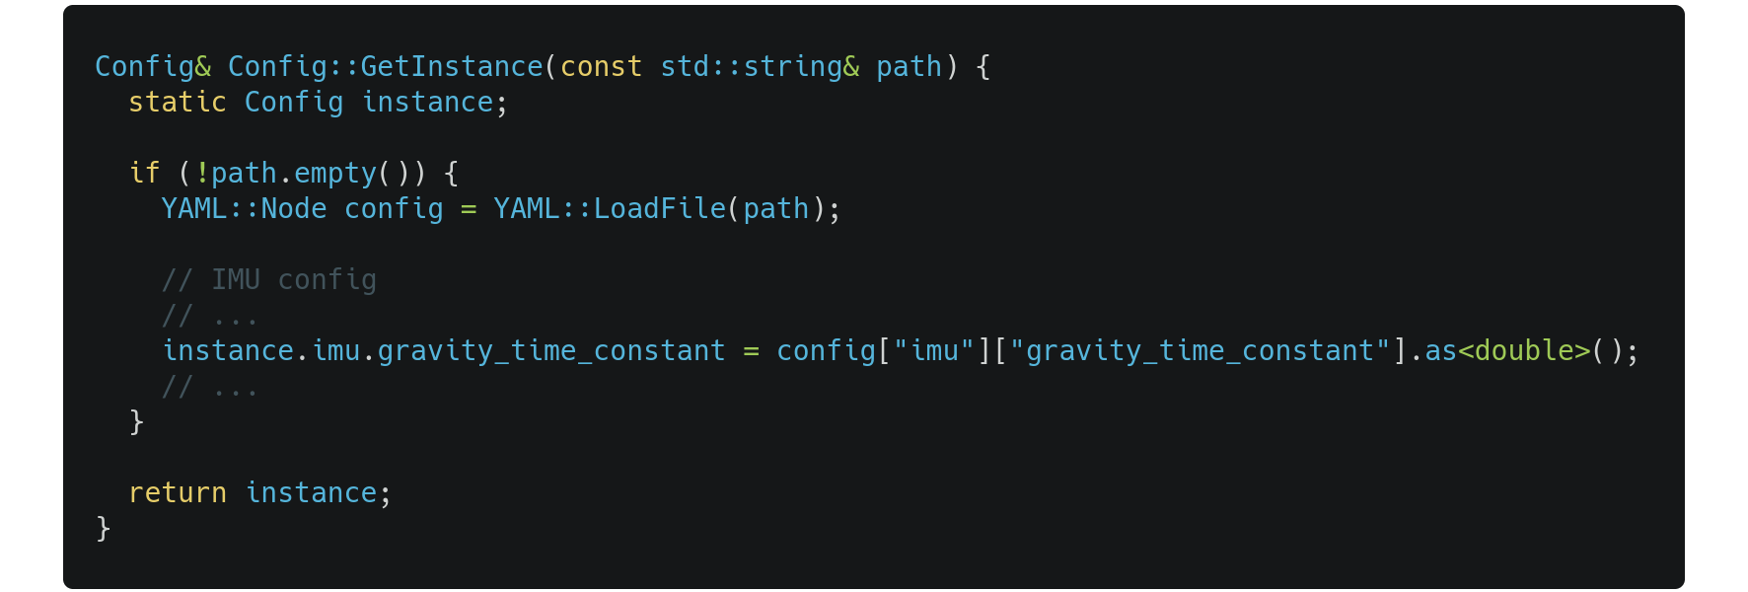
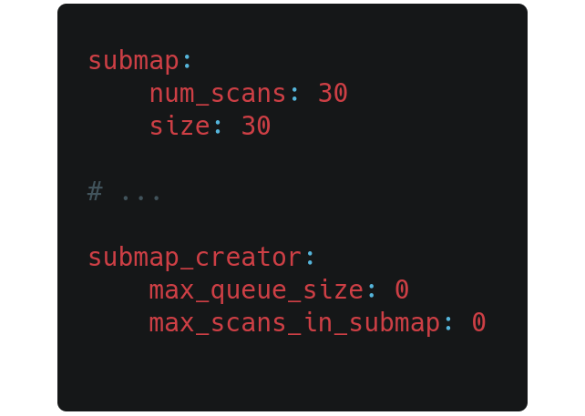
Configuration
Parameters can be restored from a YAML file (example in warp_slam/test/assets)

Slide 5
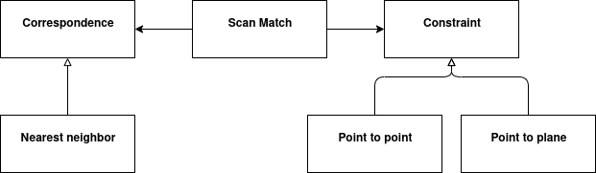
Optimization / Scan Match
Returns a transformation that aligns two point clouds
Transform optimize(submap, scan)
Initialize a transformation as identity
Loop until end of optimization
Apply transformation to scan
Calculate correspondences
For each correspondence create a constraint (point to point)
Add the constraints to the optimization problem

Slide 6
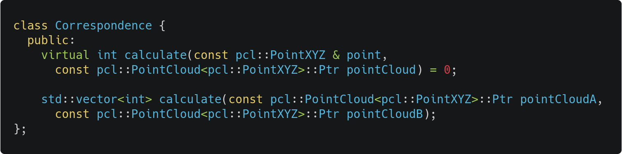
Optimization / Correspondence
Base class for any kind of correspondences
Returns the index of the corresponding point to point in pointCloud

Slide 7
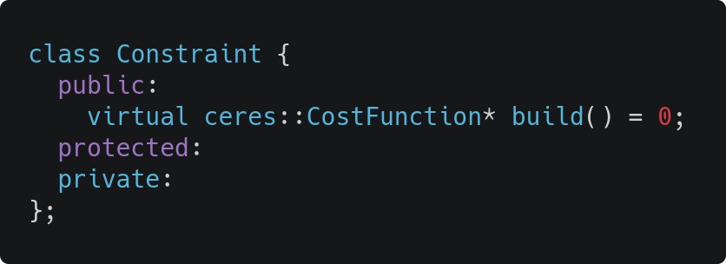
Optimization / Constraint
Builds a cost function for the Google Ceres Solver
At the moment there is only one child: point_to_point.cc
Open-closed principle: It is very easy to extend to other constraints such as point_to_plane thanks to inheritance

Slide 8

VPN
https://www.notion.so/VPN-7a5e8696ebe44846995865c34696d12d

Slide 9



VPN
Deployment of a VPN for Warp
Current configuration:
warp-cloud-dev/vpn-server
IP: 34.107.86.221
https://hub.docker.com/r/kylemanna/openvpn/
https://github.com/kylemanna/docker-openvpn

Slide 10
GPS
https://gitlab.com/paverobotics/vehicle/vehicle-core
vehicle-core/sensors/gps
deployment/pulumi/gps

Slide 11
GPS
Docker image that deploys the ublox package
Pulumi deployment to deploy the GPS into the cluster
A word of advice:
Do not try to setup a GPS indoors
(even if gps is hanging out from the window)
😅
https://github.com/KumarRobotics/ublox.git

Slide 12
grid2occupancy
https://gitlab.com/paverobotics/cloud/pointcloud-to-grid/
pointcloud-to-grid/src/grid2occupancy

Slide 13
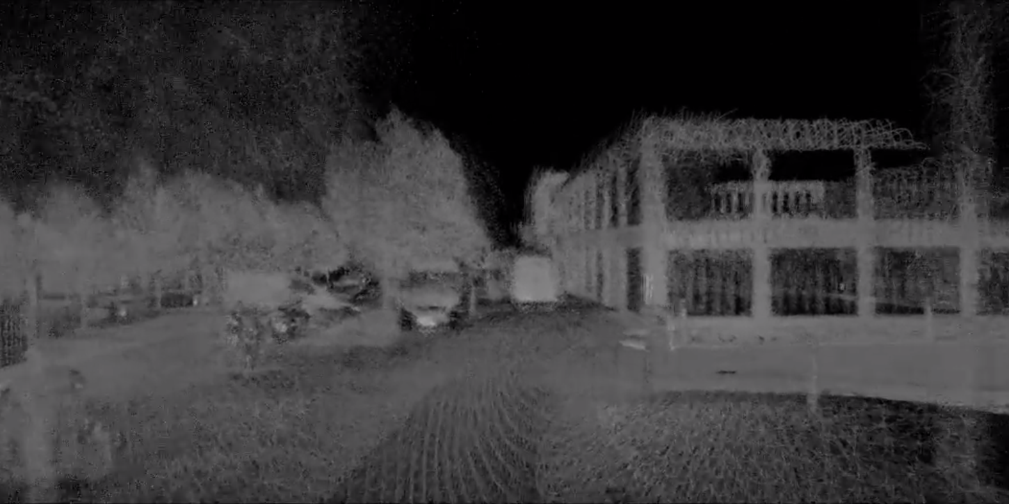
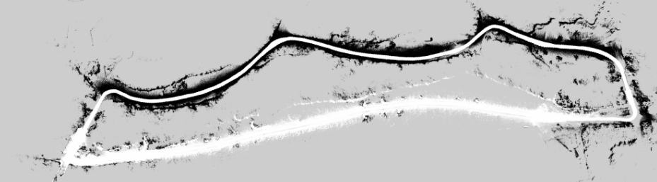
Description
A ROS package that generates a costmap for the planner
Two use cases
From a point cloud (PCD)
From a grid map
It can use trajectory information to free the path
It uses the segmentation labels of the points to adjust the cost
It is also available as a Docker Image

Slide 14
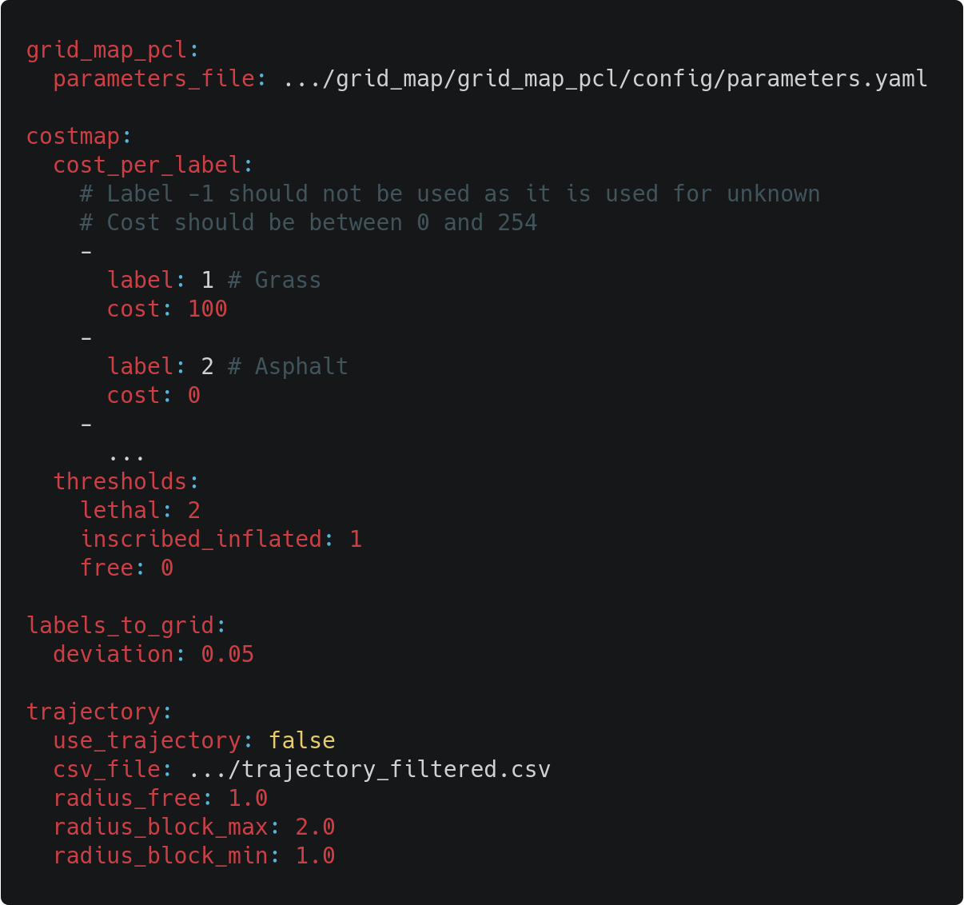
Parameters
A class that holds all parameters for the package
Singleton pattern
The parameters are loaded from a YAML file
Full description of the parameters in grid2occupancy/README.md

Slide 15
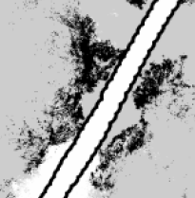
Trajectory extraction
A Jupyter notebook used to extract the coordinates of the trajectory
Three steps:
Convert the pbstream into a bag file
Convert the bag file into a csv
Extract x,y,z fields from the csv
A circle of radius trajectory/radius_free is marked as free
The area between two circles with radius trajectory/radius_block_min and trajectory_radius_block_max is marked as blocked
pbstream_trajectories_to_rosbag_main.cc
https://github.com/AtsushiSakai/rosbag_to_csv

Slide 16
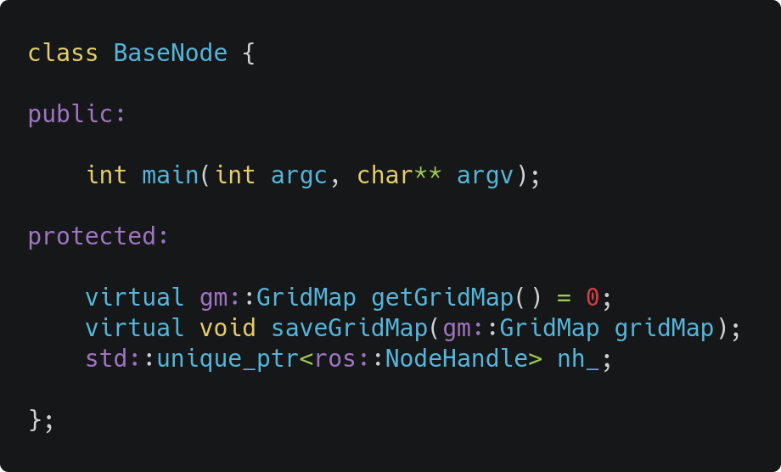
BaseNode
Contains the common behaviour between the two use cases
Initialize ROS
Get a grid map
Adjust values of unknown cells
Shift all cells such that the minimum is zero
Free trajectory if required
Generate a costmap
Save the costmap using ROS map server

Slide 17
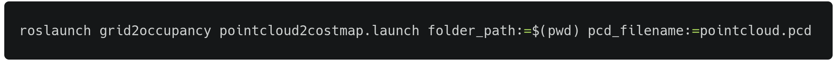
pointcloud2costmap node
Node that converts a PCD into a costmap
Convert the PCD into a grid map using the GridMapPclLabelLoader class
The grid map is saved into a bag file in folder_path/preprocessed_gridmap.bag in the topic /gridmap
Input
folder_path
parameters.yaml
pcd_filename
Output
folder_path
costmap (yaml and pgm)
preprocessed_gridmap.bag

Slide 18
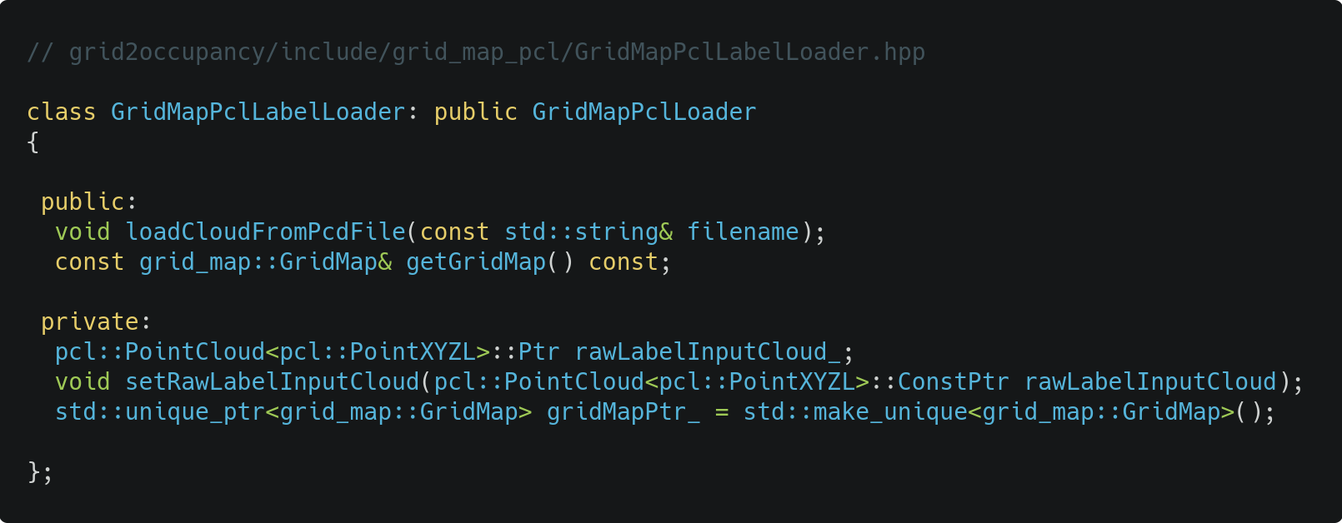
GridMapPclLabelLoader
A custom class that inherits from GridMapPclLoader
It adds support for points with the fields x,y,z,Label
getGridMap()
It gets the grid map generated by the parent class (elevation)
It creates a new layer (labels). For each cell (x,y), it assigns the most common label of the points contained in that cell at that elevation. (± labels_to_grid.deviation)

Slide 19
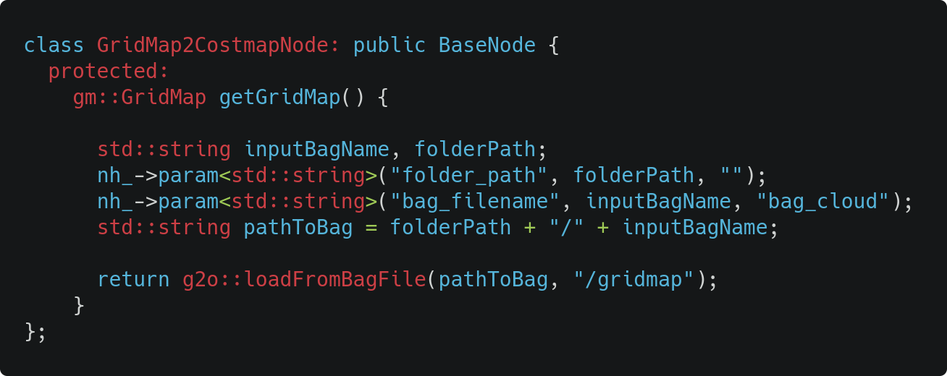
gridmap2costmap node
Inherits from BaseNode
getGridMap() loads a bag file containing the preprocessed gridmap stored by the previous node
Input
folder_path
parameters.yaml
bag_filename
Output
folder_path
costmap (yaml and pgm)

Slide 20
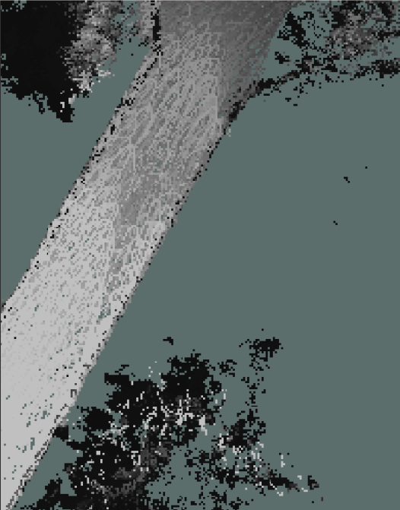
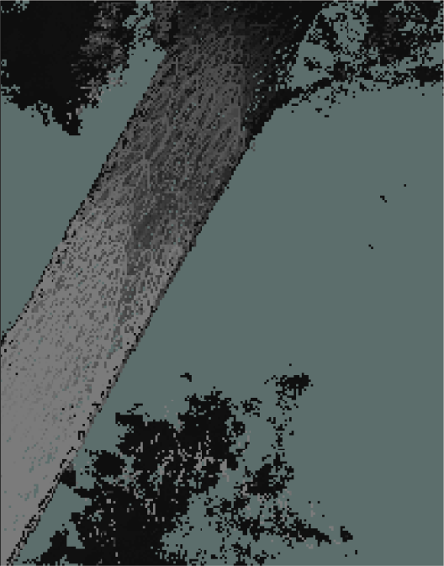
Outputs with different cost per label
Cost: 0
Cost: 100

Slide 21
Next steps
The conversion from grid map to cost map is done using the grid_map/grid_map_costmap2d package which uses absolute elevation to set the cost for the cells
A better solution would be computing the normals and using them to know if the vehicle can reach that cell

Slide 22
Autonomous driving.
Everywhere.

